Slide 1
Book1 PORUS SHEET STORY 3
File created on: 10/31/2023 7:52:39 AM

Slide 2
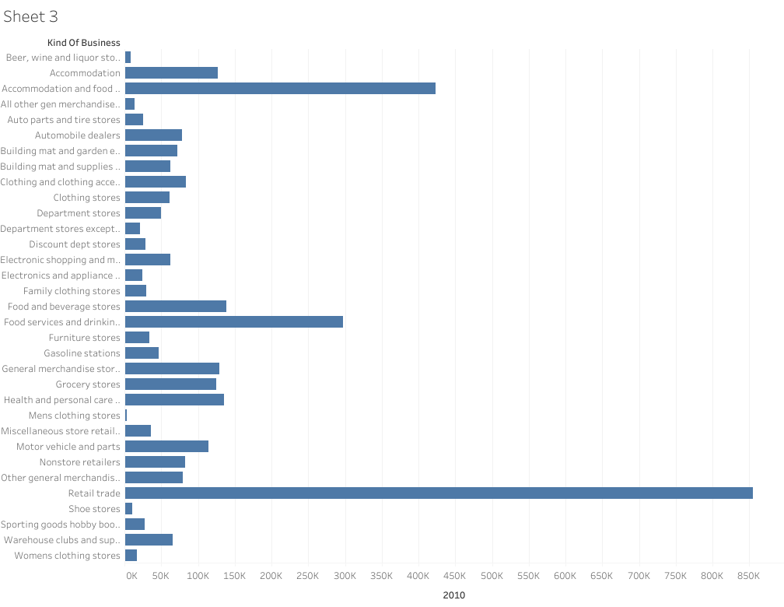

Slide 3
